Slide 1

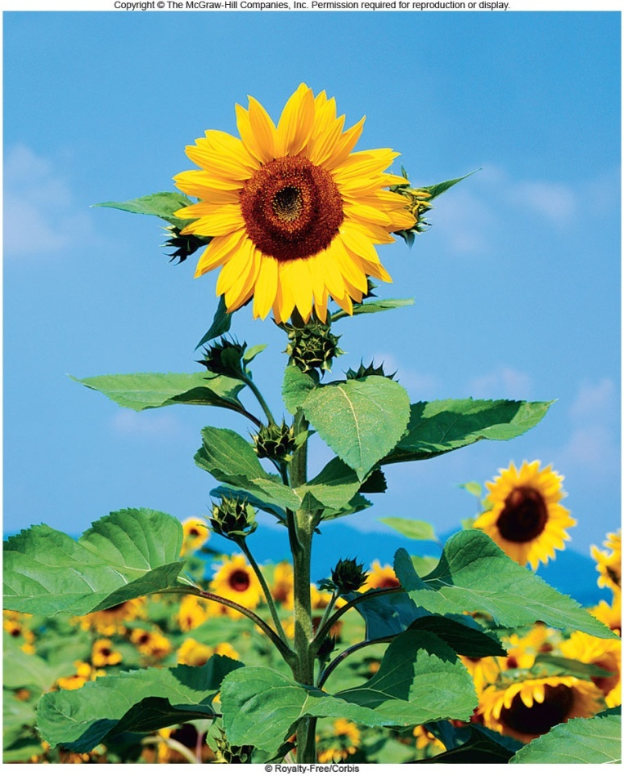
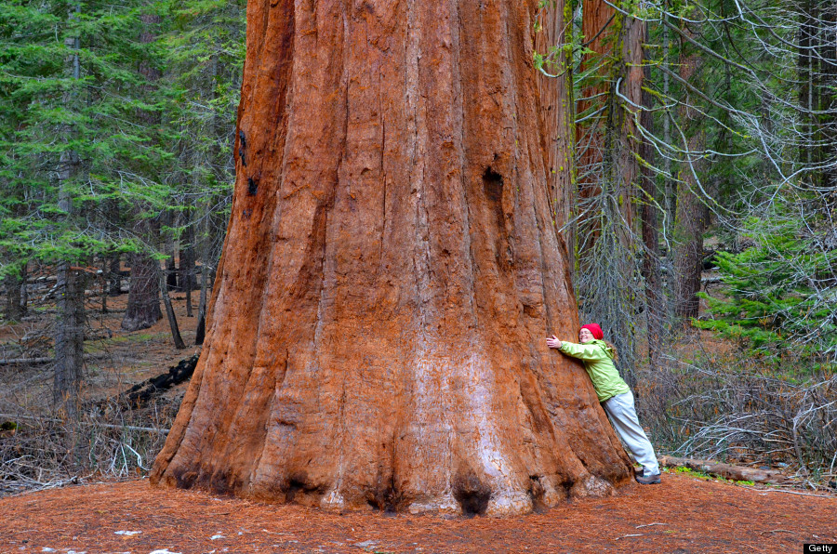
Energy and Life video

Slide 2
Energy comes in many forms including mechanical, heat, and chemical
Living things need energy to survive.
This energy comes from the sun.
Plants and some other types of organisms are able to use energy from the sun to produce food.

Slide 3

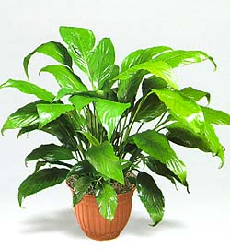
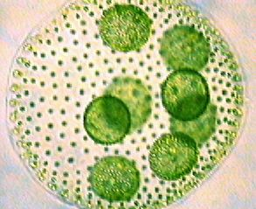
Autotrophs vs. Heterotrophs
Organisms such as plants that make their own food are known as autotrophs.

Slide 4
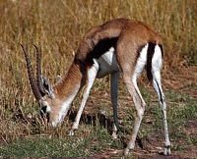
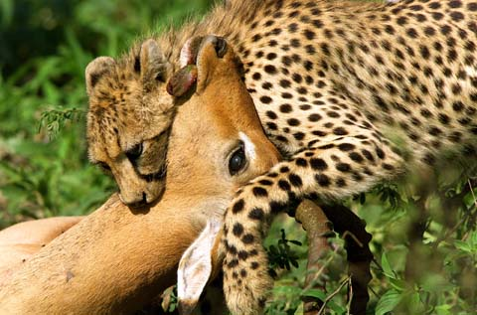
Heterotrophs
Organisms such as animals that must make energy from the foods they consume are called heterotrophs.

Slide 5
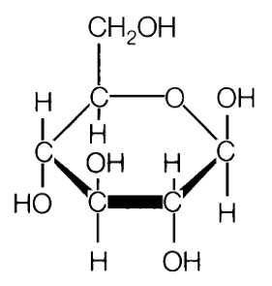
Glucose
Glucose is called the fuel of life
    Monosaccharide (One sugar)
    Chemical Formula: C₆H₁₂O₆
Contains too much energy for cells to use all at once
    Must convert this large amount of energy into a usable form
    Like getting change from a vending machine

Slide 6

Chemical Energy and ATP
An important chemical compound that cells use to store and release energy is called adenosine triphosphate (ATP)
ATP is used by all types of cells as a basic source of energy.
ATP consists of:
Sugar (Ribose)
Nitrogen Base (Adenine)
3 Phosphate groups

Slide 7
Storing Energy
ADP has 2 phosphate groups instead of 3.
A cell can store small amounts of energy by adding a phosphate to ADP.
ATP is like a fully charged battery

Slide 8
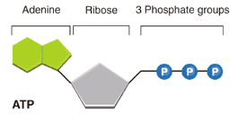
Releasing Energy
Energy stored in ATP is released by breaking the chemical bond between the second and third phosphates.
2
2
ADP

Slide 9
ATP and ADP
2

Slide 10

Using Biomechanical Energy
What is ATP is used for?
  Active Transport
  Movement of organelles throughout cell
  Synthesis of proteins and nucleic acids
  Movement of cilia and flagella

Slide 11
ATP Availability
Most cells only have enough ATP for a few seconds of activity
Why?
    Not good at storing energy for the long term
    Glucose stores 90 times the chemical energy of ATP
    Cells generate ATP from ADP as needed by using the energy in foods like glucose

